Slide 1
Concurrency
Saint Petersburg, 2019

Slide 2
Content
1
Concurrent computing
2
Advantages
1
Performance
2
Resource utilization
3
Latency decreasing
3
Wonders
1
Races
2
Complexity
3
Tech issues
4
Conclusion

Slide 3
Hardware basics

Slide 4
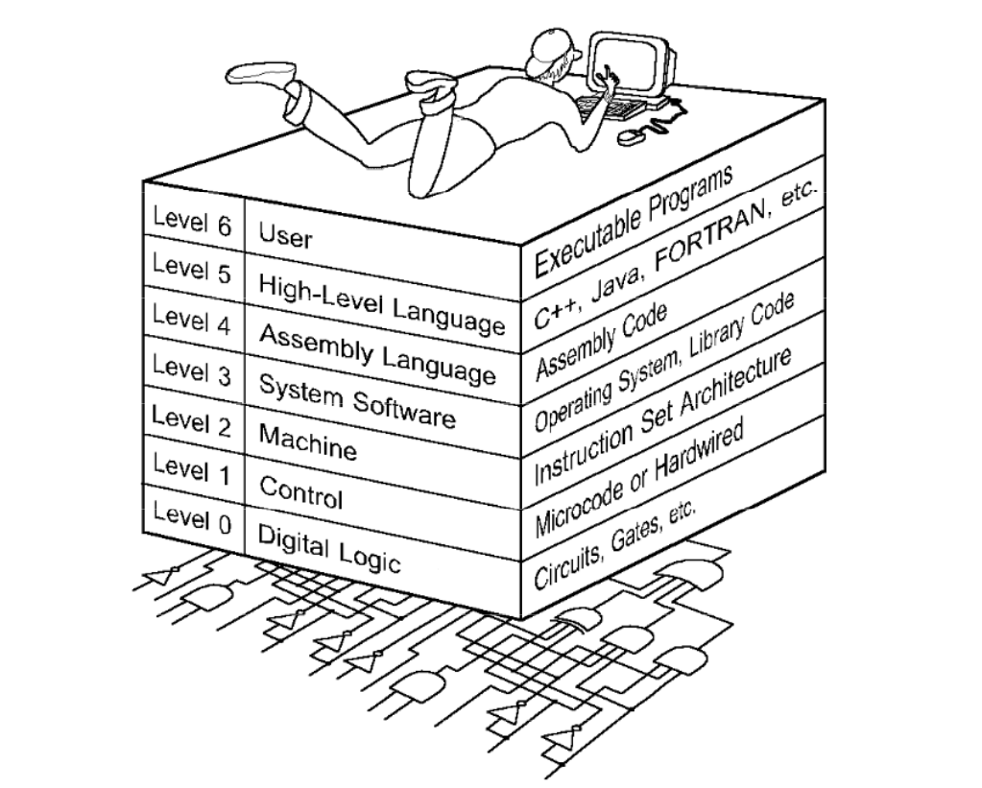
The World we are living in

Slide 5
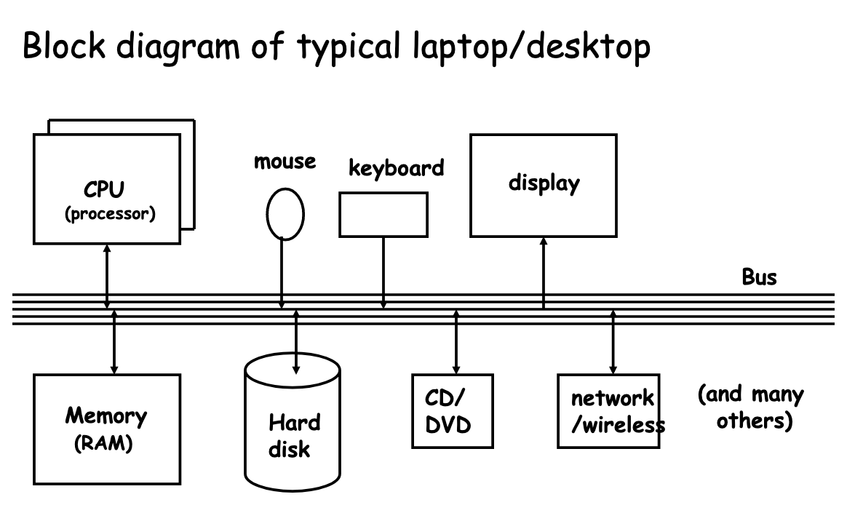
Computer architecture

Slide 6
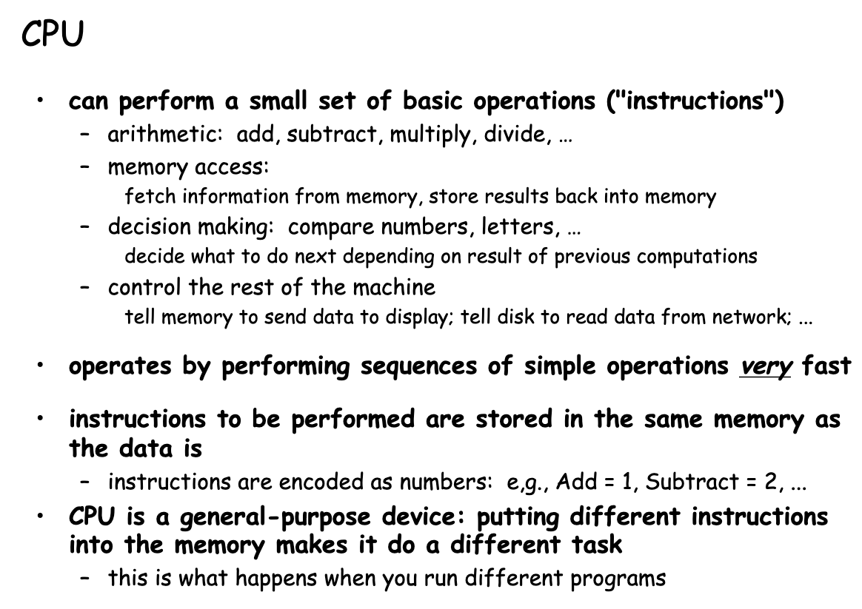
CPU

Slide 7
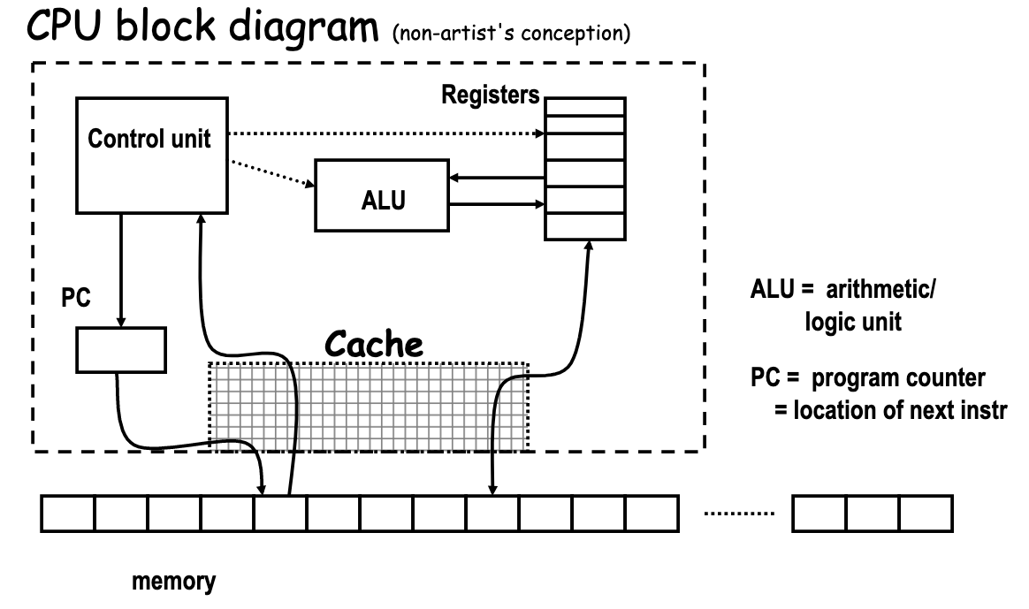
CPU

Slide 8
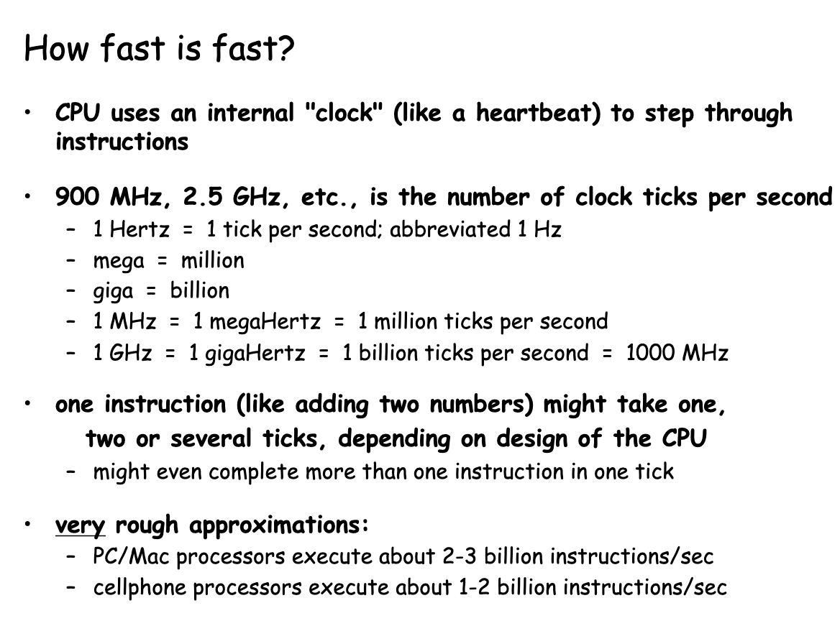
CPU

Slide 9
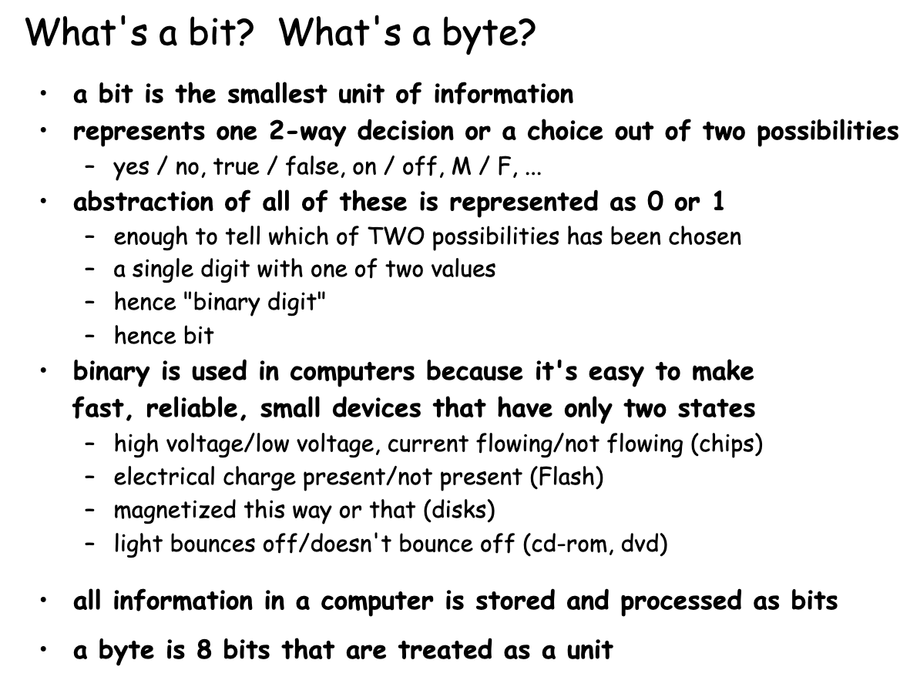
CPU

Slide 10
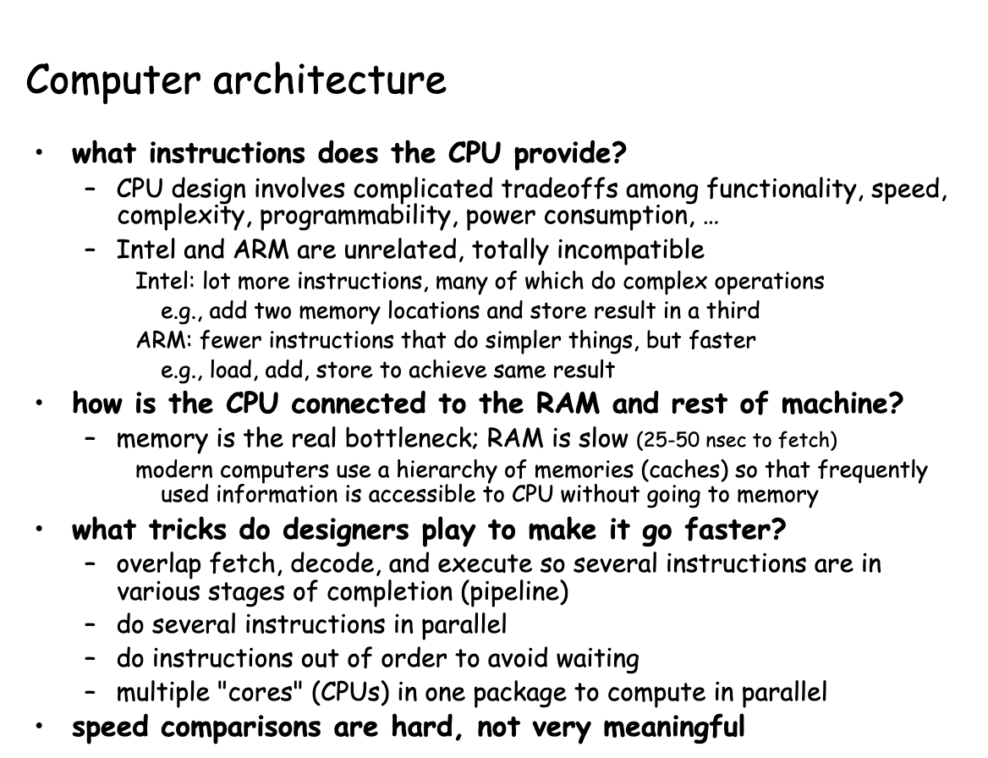
Computer architecture

Slide 11
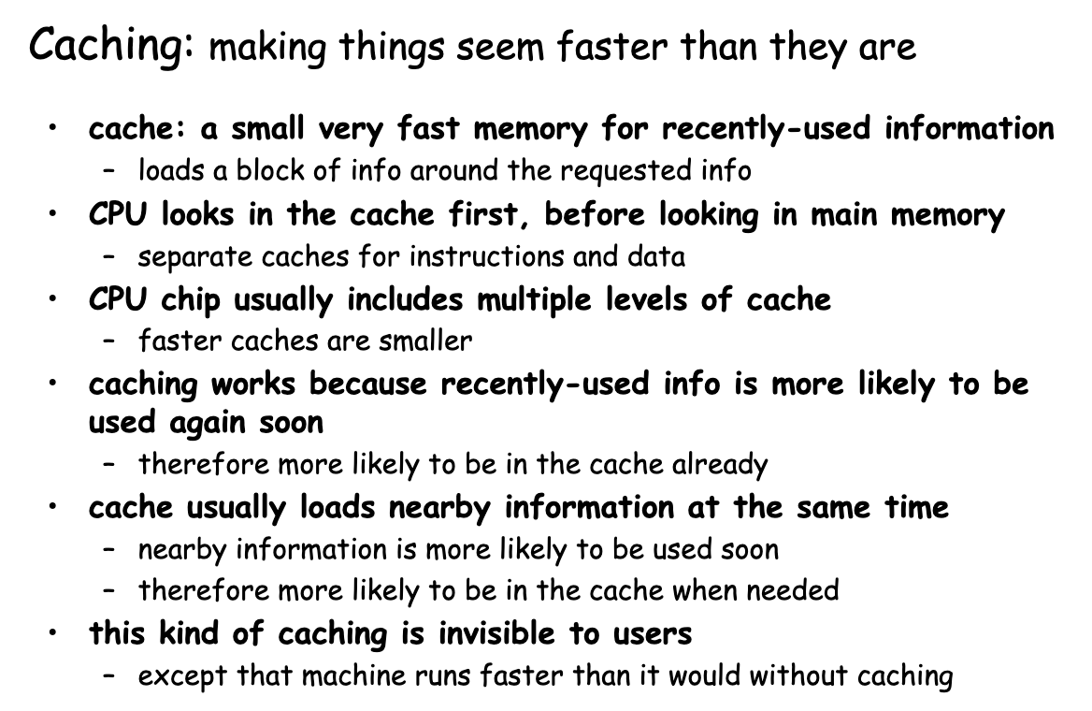
CPU architecture

Slide 12
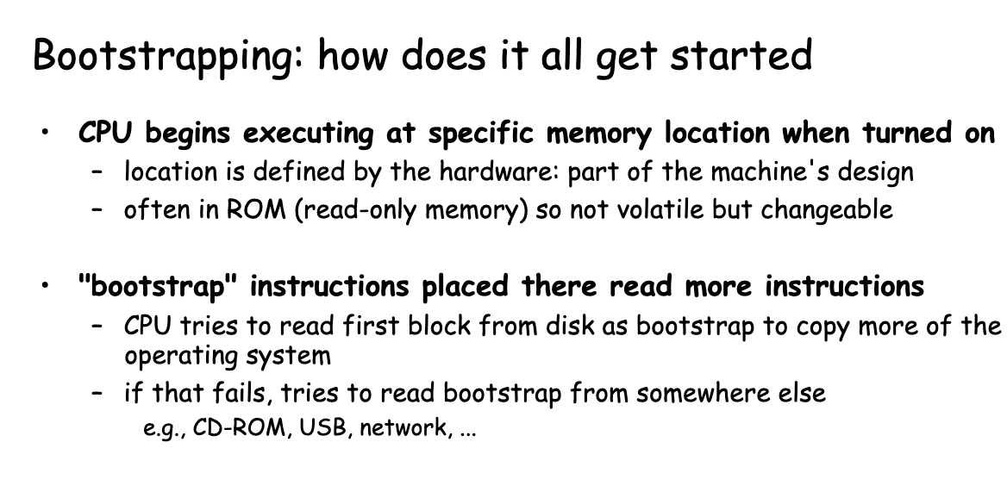
Bootstrapping

Slide 13
Software basics

Slide 14
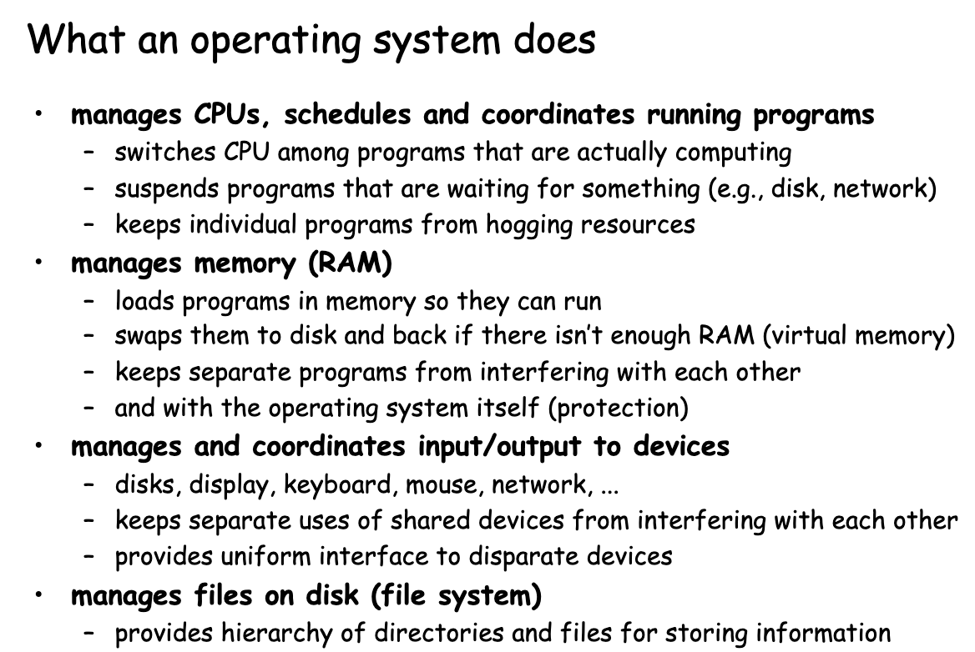
OS

Slide 15
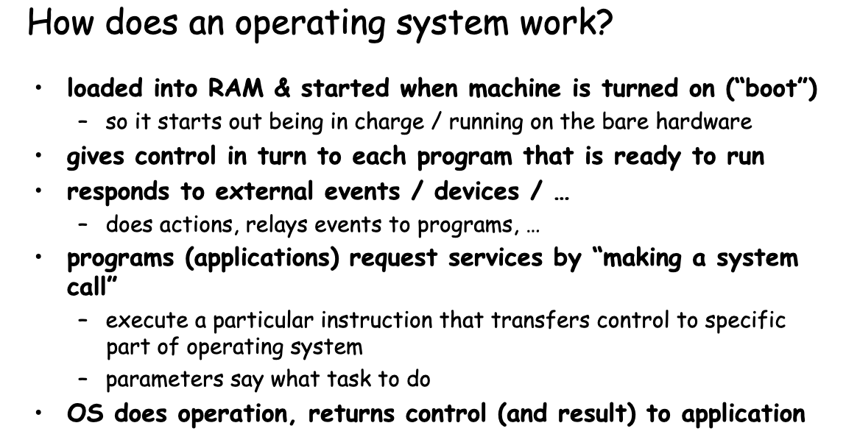
OS

Slide 16
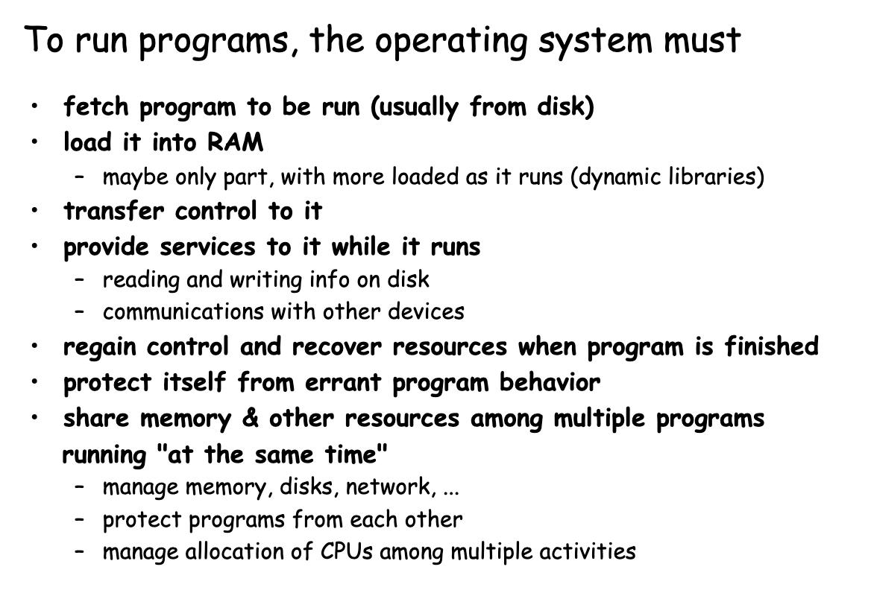
How processors work?

Slide 17
Java basics

Slide 18
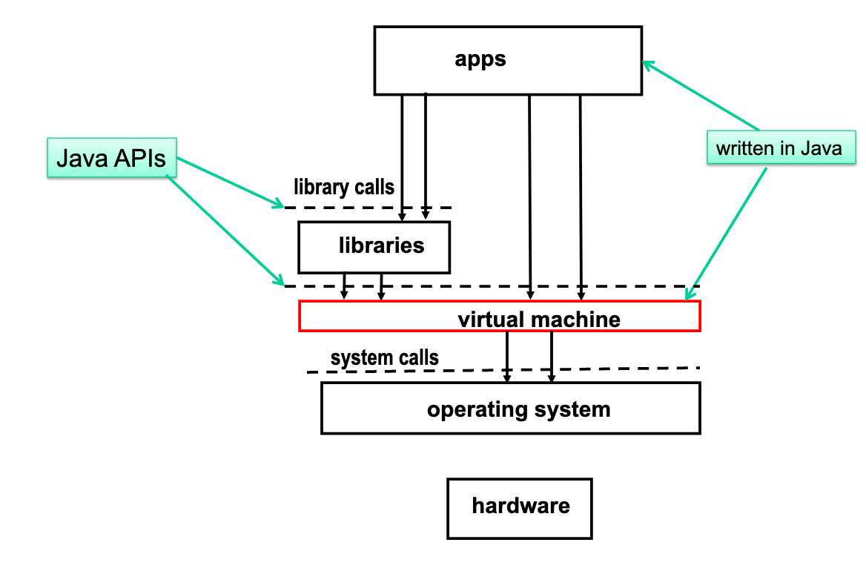
JVM execution architecture

Slide 19
How processors work?

Slide 20
Concurrent computing is a form of computing in which several computations are executed during overlapping time periods—concurrently—instead of sequentially (one completing before the next starts)
Definition

Slide 21
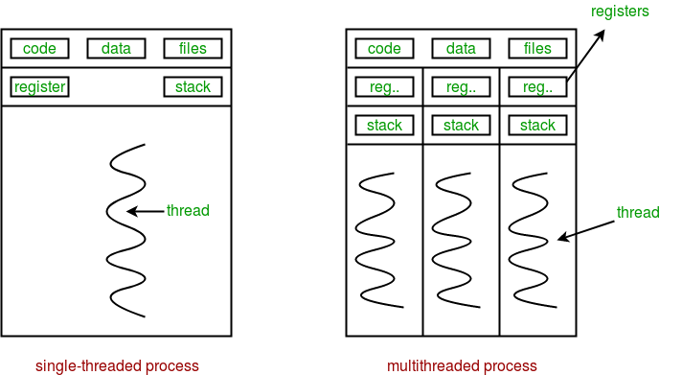
Sequential vs concurrent

Slide 22
Performance

Slide 23
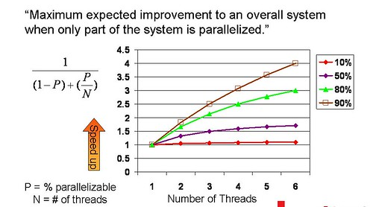
Amdahl's law

Slide 24
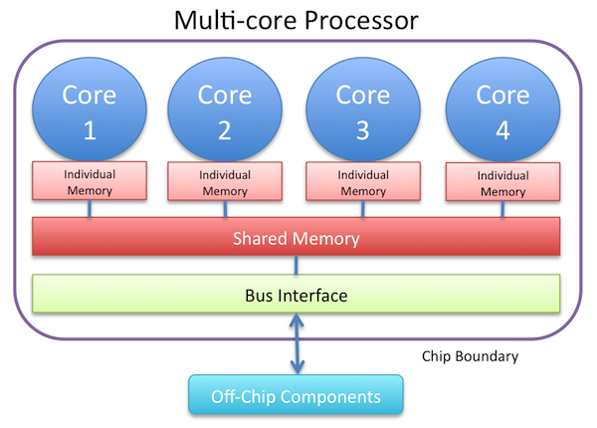
Resource utilization

Slide 25
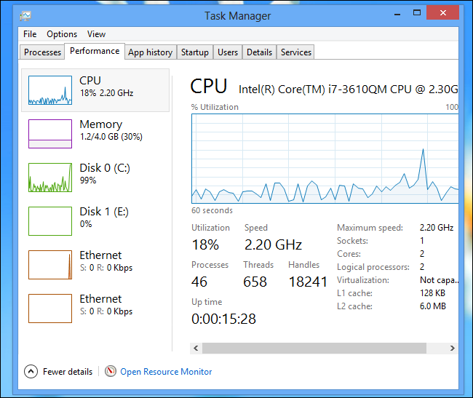
Resource utilization

Slide 26
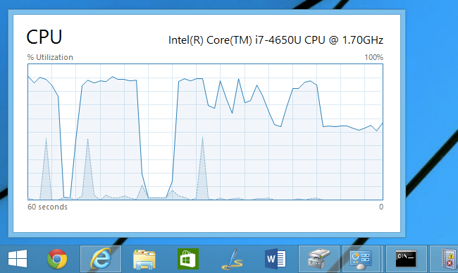
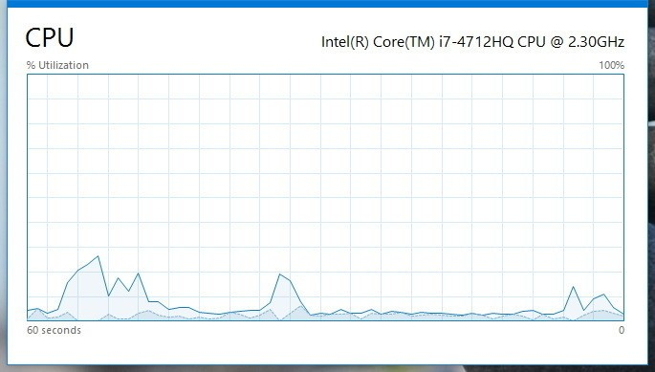
Resource utilization

Slide 27
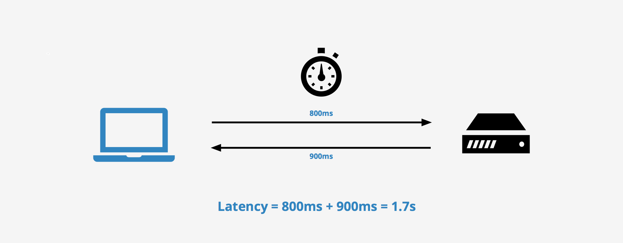
Latency

Slide 28

Modern way

Slide 29
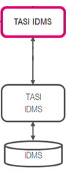
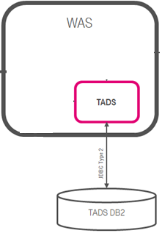
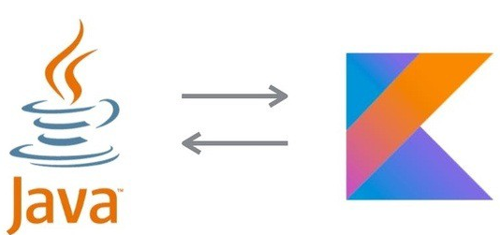
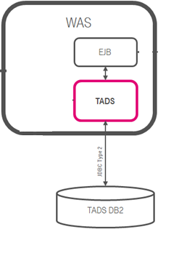
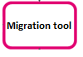

Concurrent Dijkstra algorithm

Slide 30
Multi thread migration

Slide 31
Single thread migration
7h21 min 1.7 r/s

Slide 32
Multi thread migration

Slide 33
Multi thread migration
7h21 min 1.7 r/s
28 min 23 r/s

Slide 34
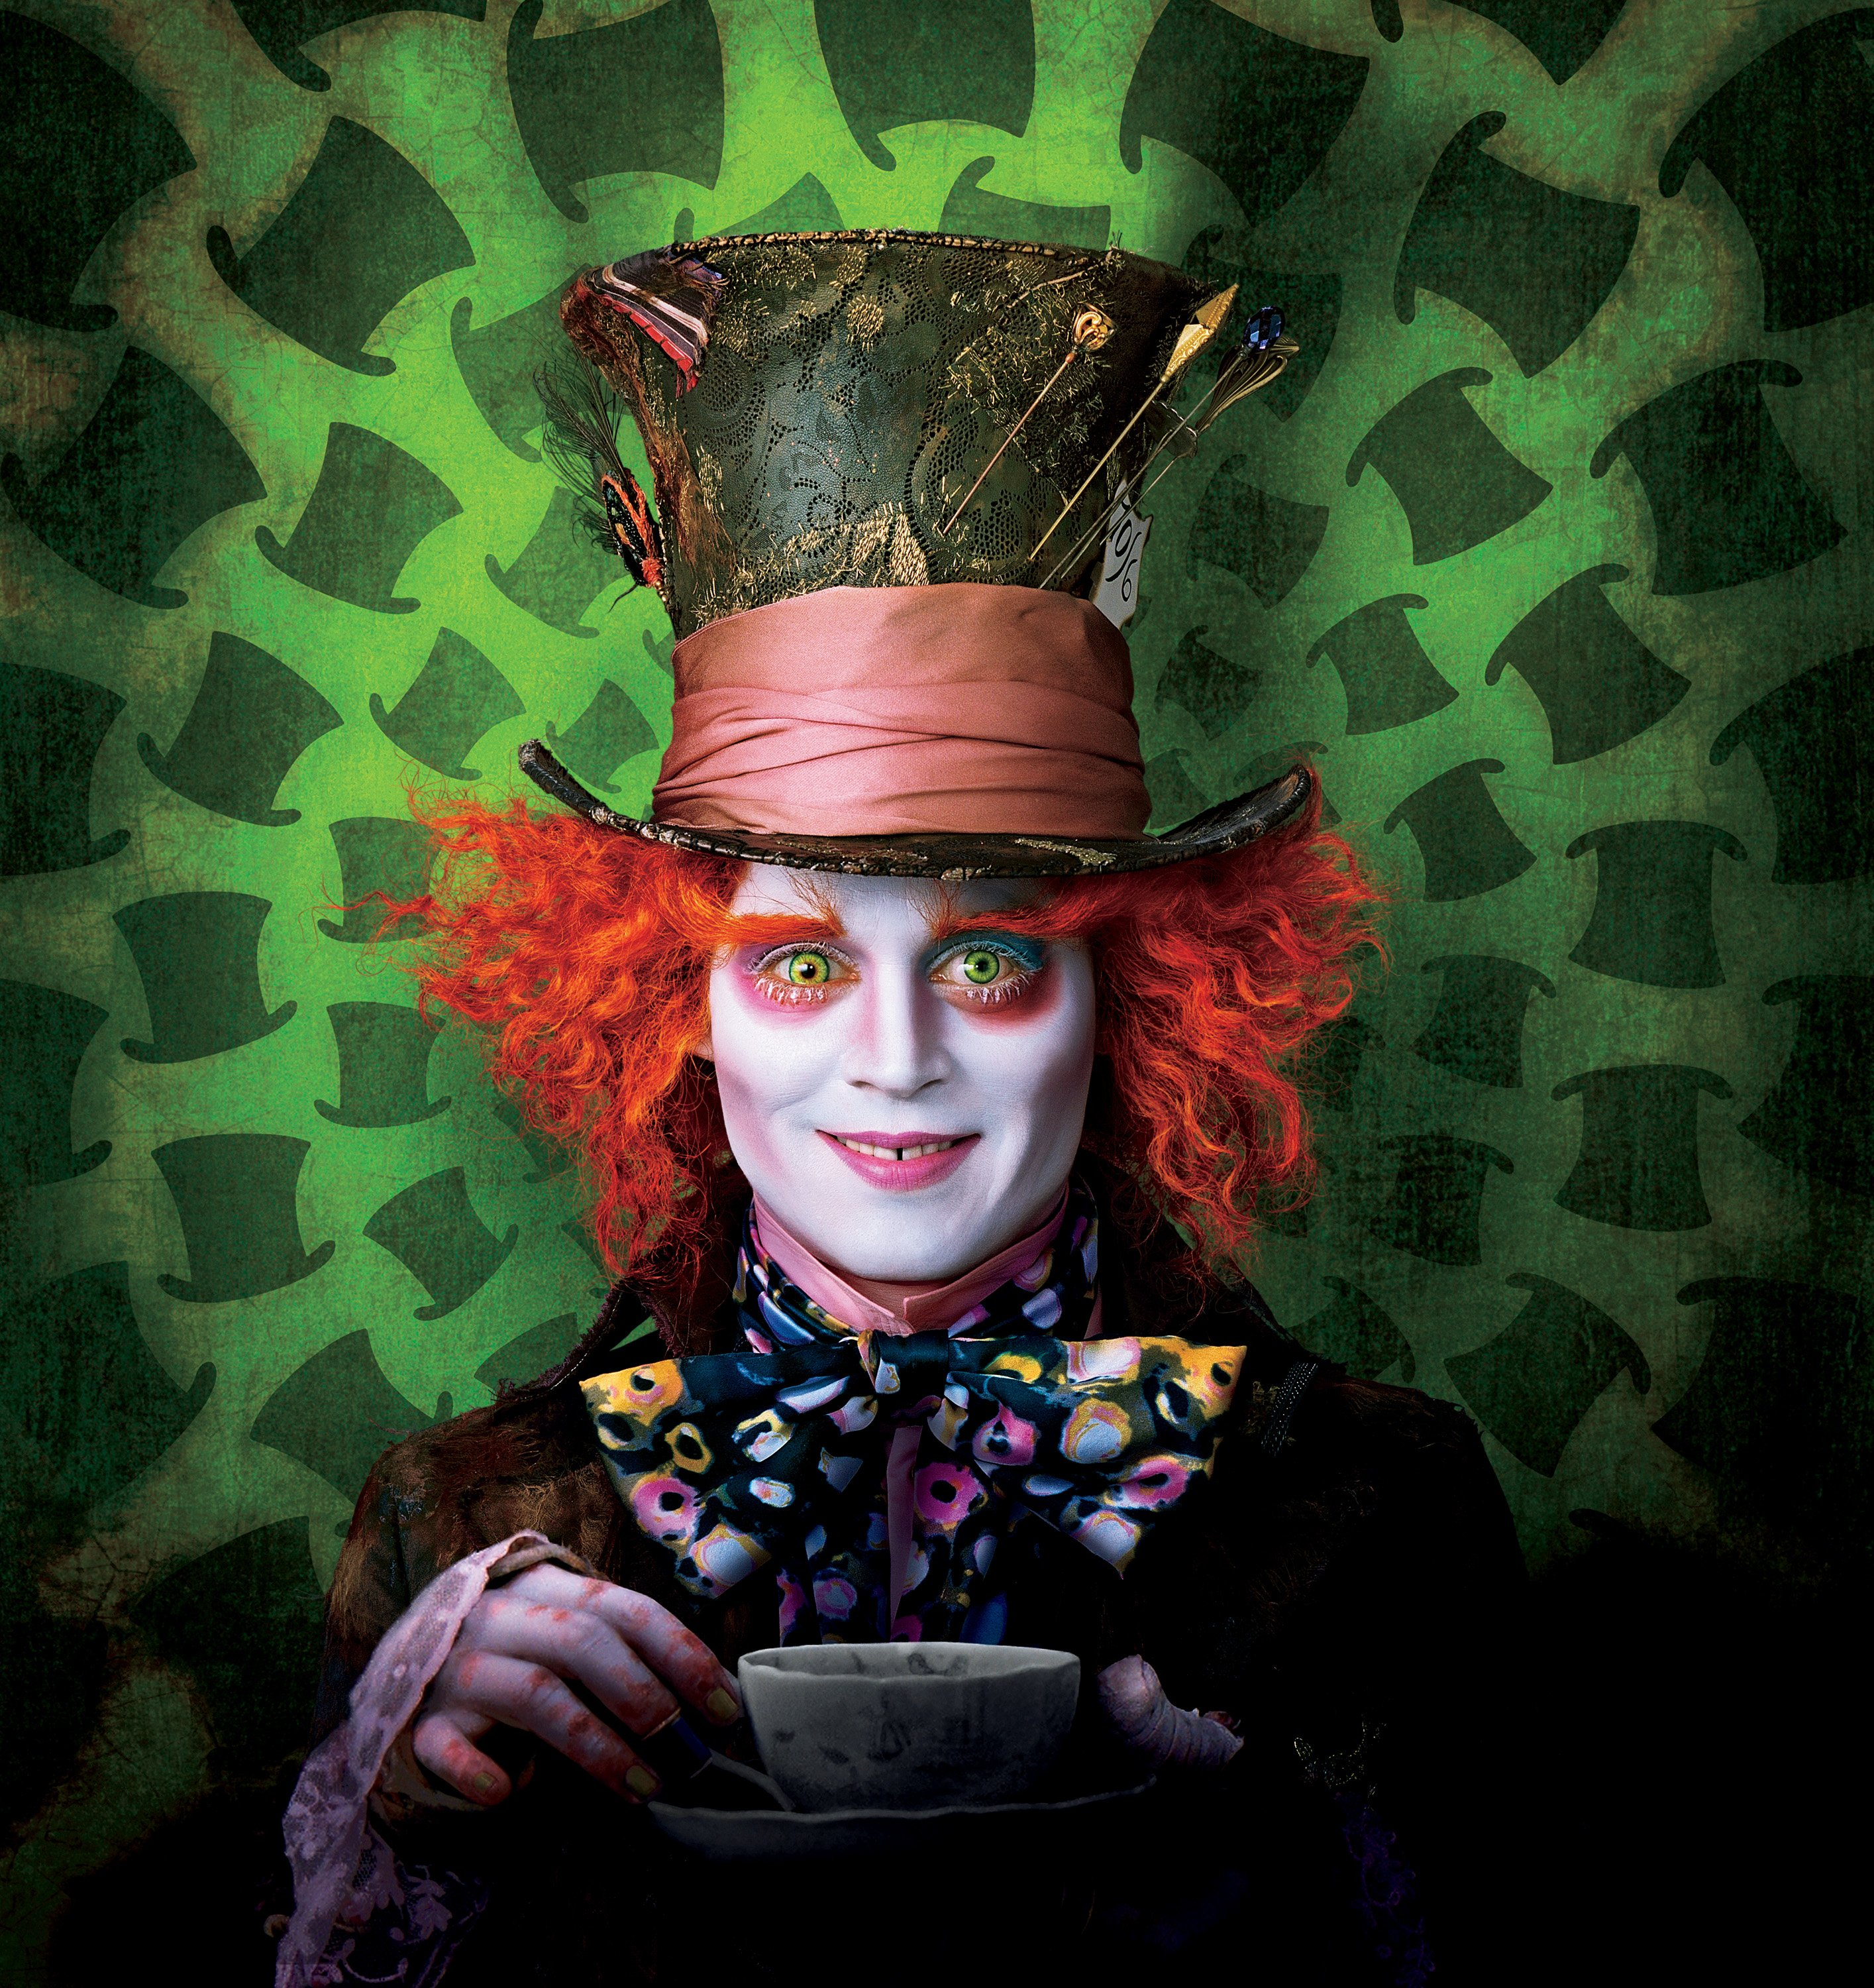
The show begins

Slide 35
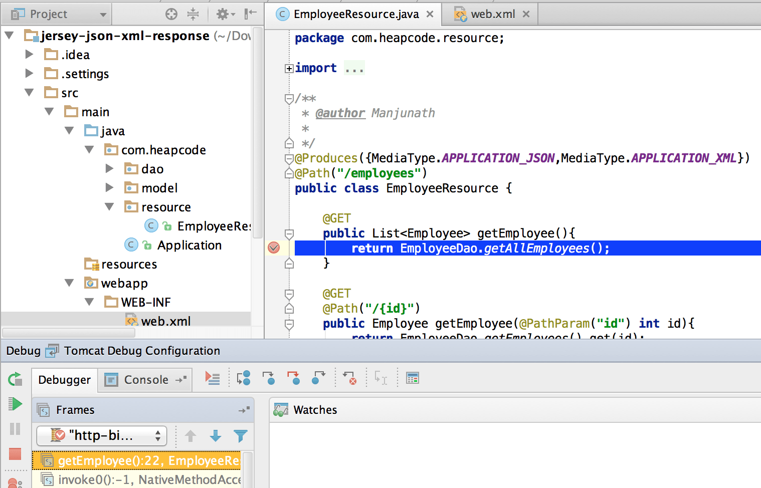
#1 Difficult to debug

Slide 36
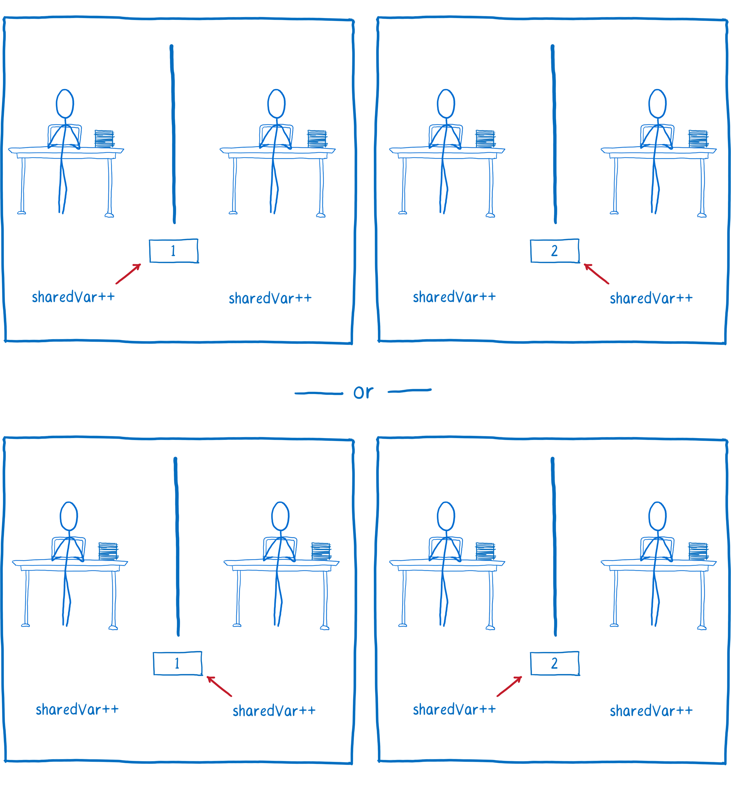
#2 Race condition

Slide 37
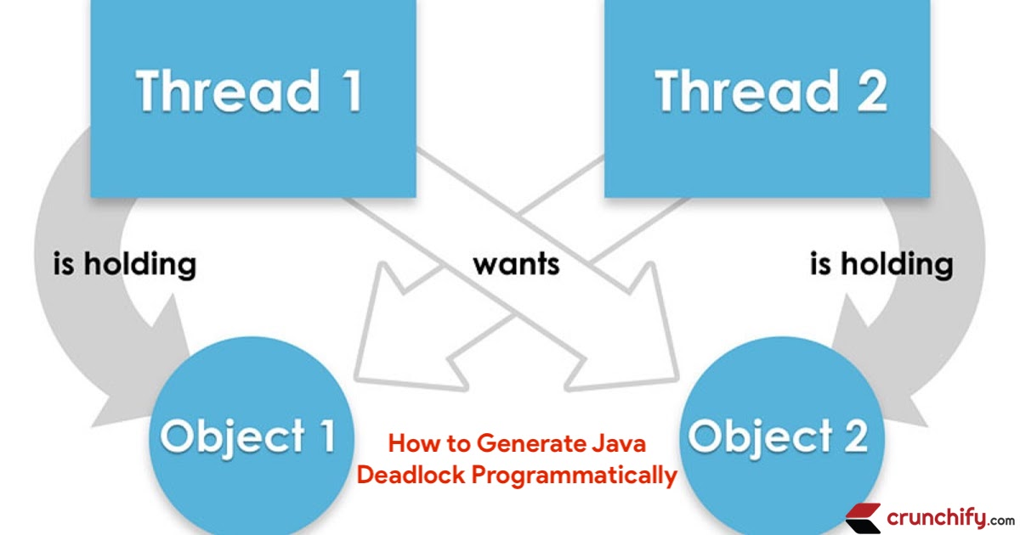
#3 Dead locks

Slide 38
Concurrency mad stuff
“But I don’t want to go among mad people," Alice remarked. - "Oh, you can’t help that," said the Cat: "we’re all mad here. I’m mad. You’re mad." - "How do you know I’m mad?" said Alice. - "You must be," said the Cat, "or you wouldn’t have come here.”
Alice's Adventures in
Wonderland by Lewis Carroll

Slide 39
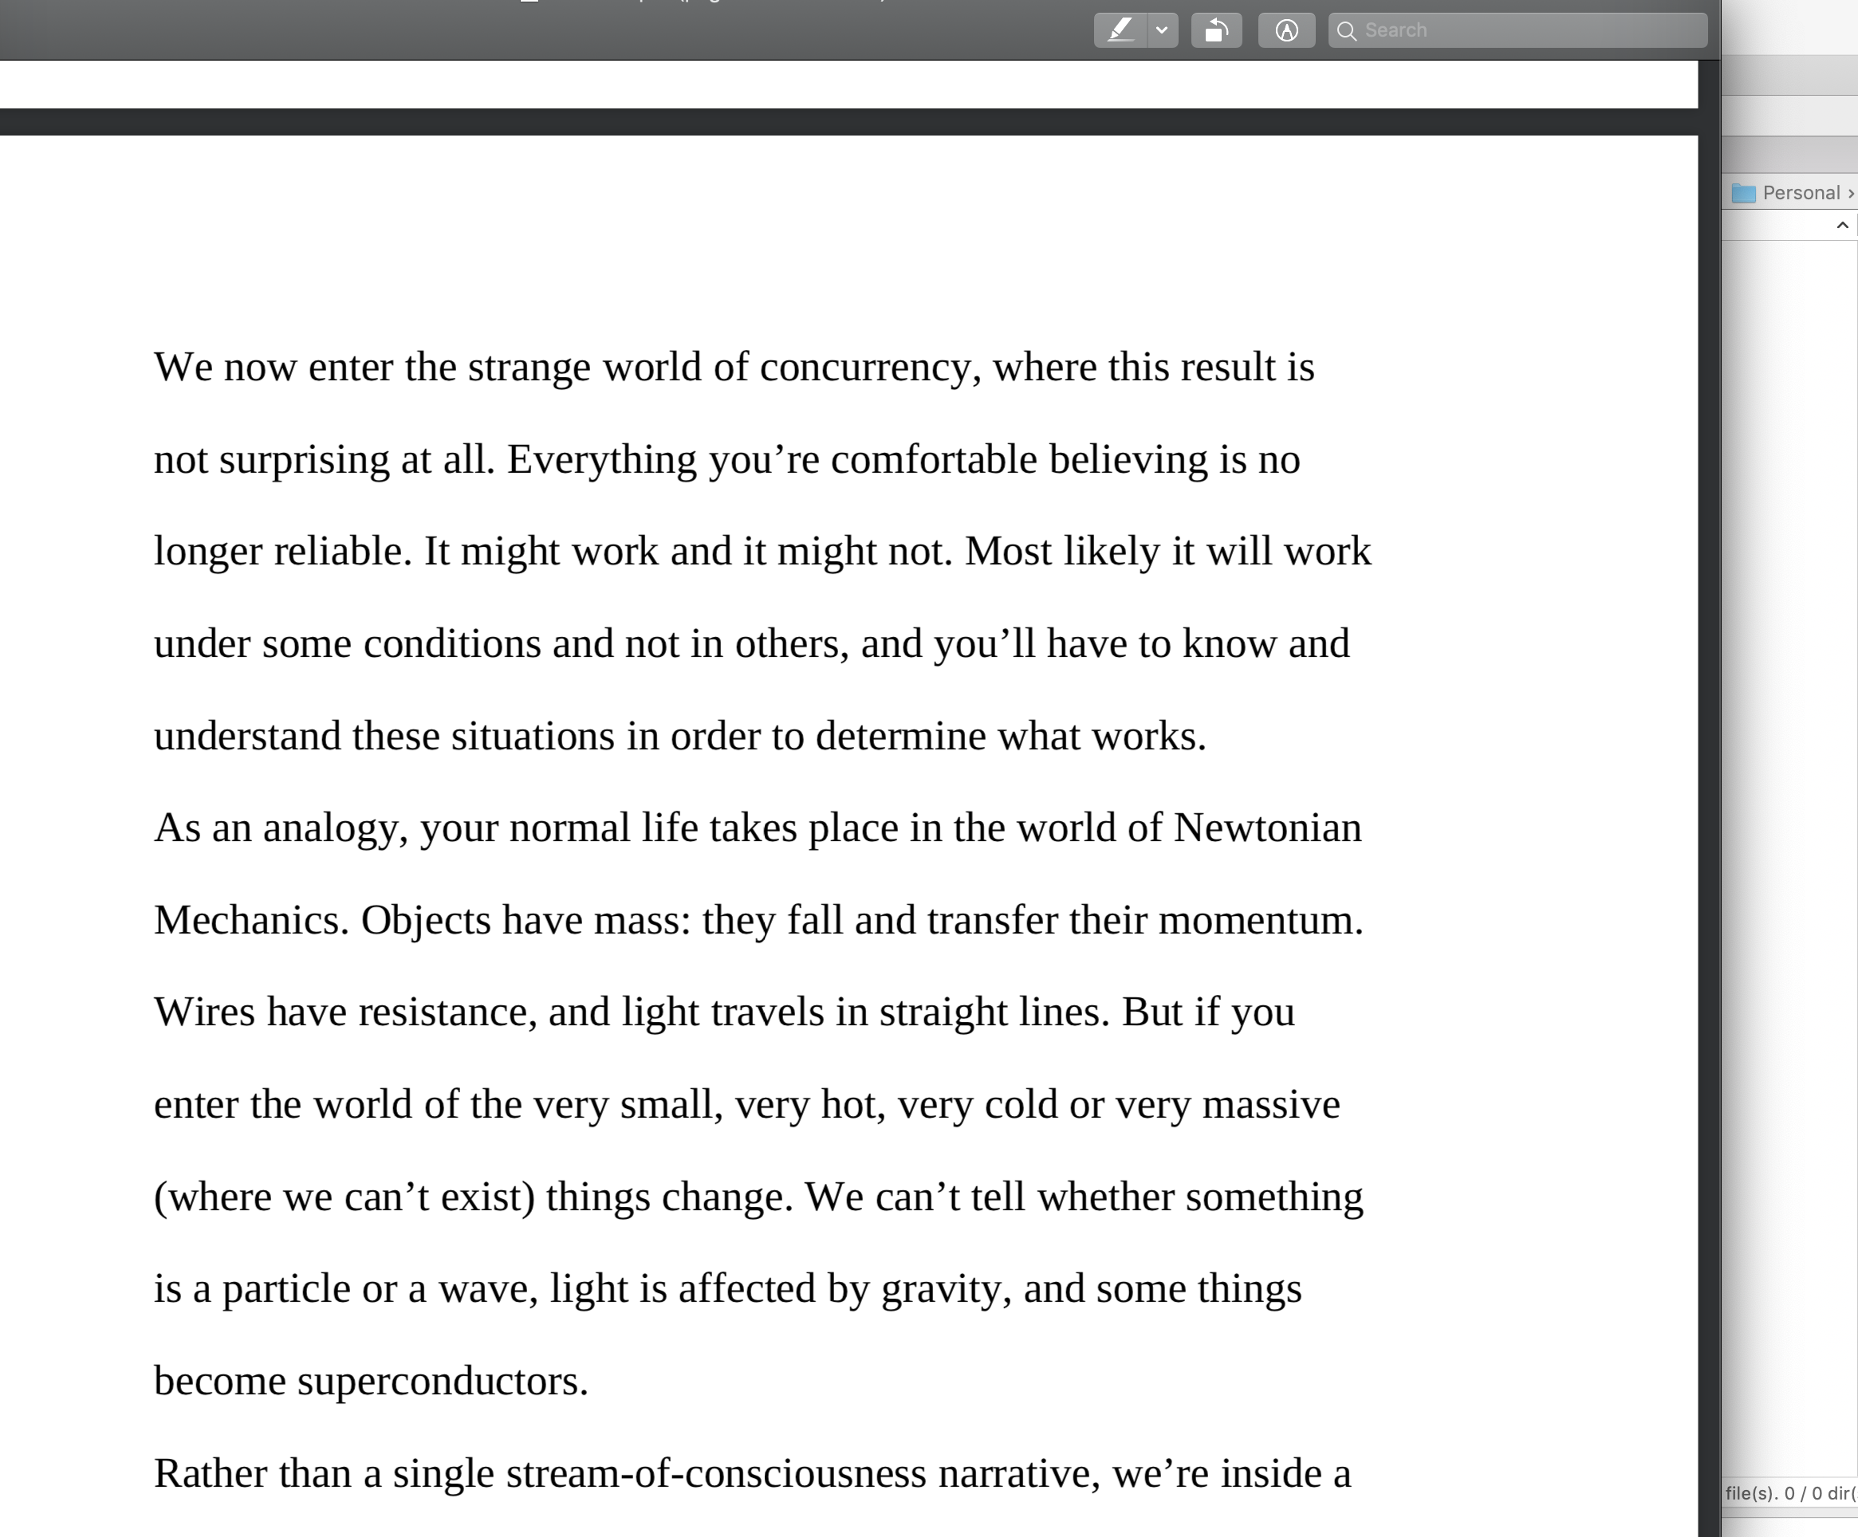
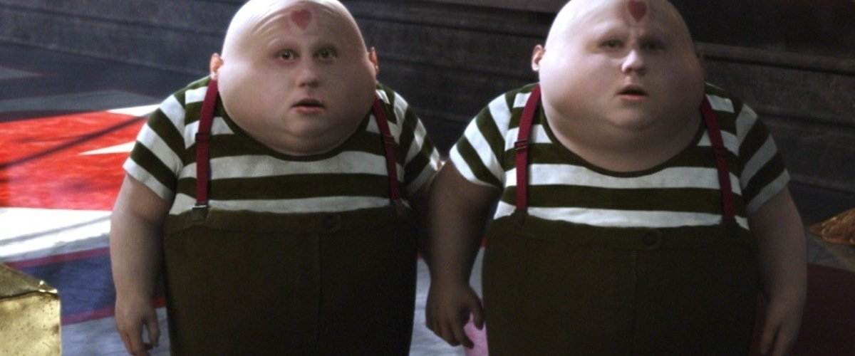
Dev practices
On Java 8 by Bruce Eckel

Slide 40
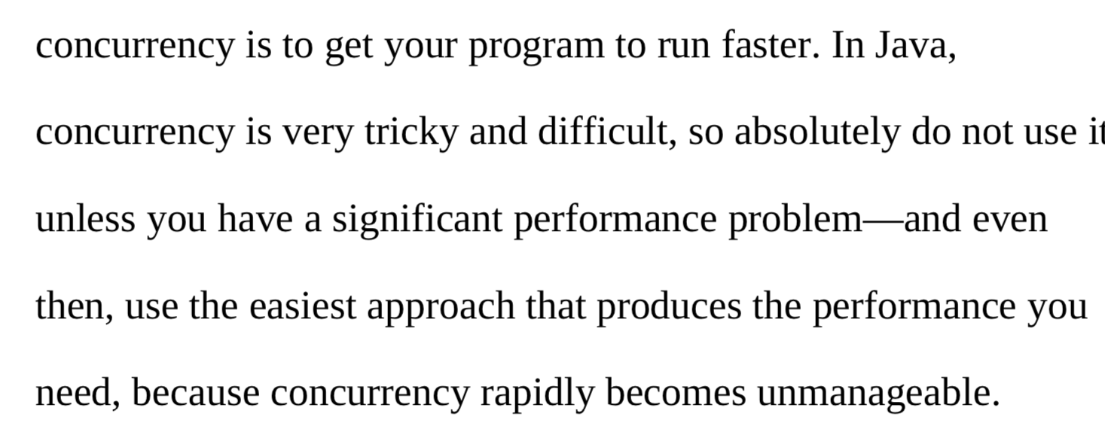
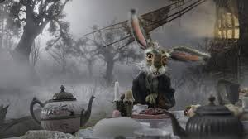
Dev practices
On Java 8 by Bruce Eckel

Slide 41
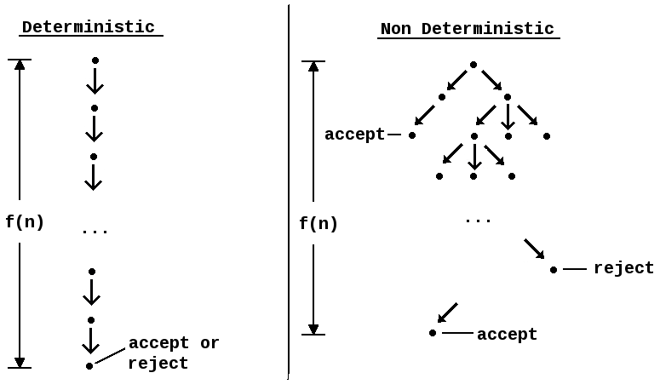
#4 Non deterministic behavior

Slide 42
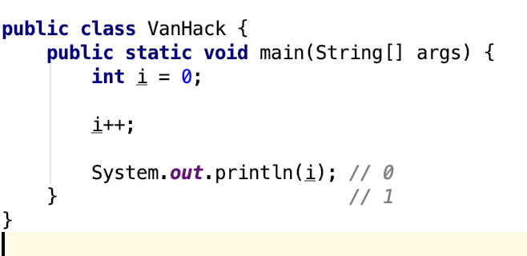
#4 Non deterministic behavior

Slide 43
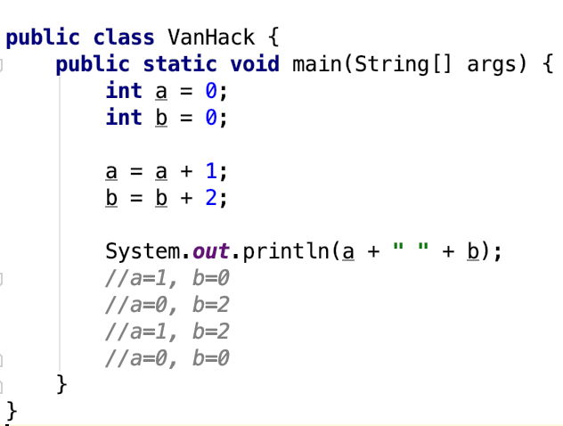
#4 Non deterministic behavior

Slide 44
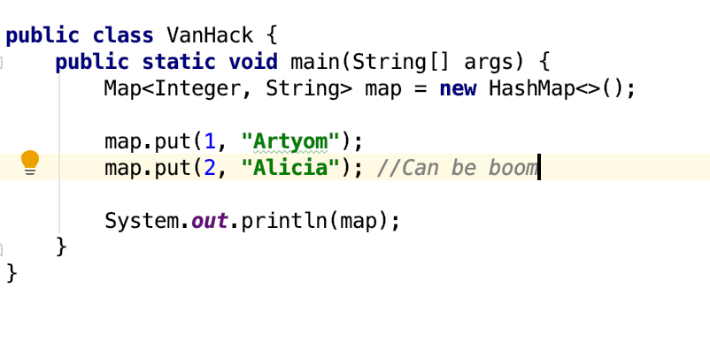
#4 Non deterministic behavior

Slide 45
Are you still here?
Twas brillig, and the slithy toves Did gyre and gimble in the wabe: All mimsy were the borogoves, And the mome raths outgrabe
Jabberwocky by Lewis Carroll

Slide 46

Let’s continue?

Slide 47
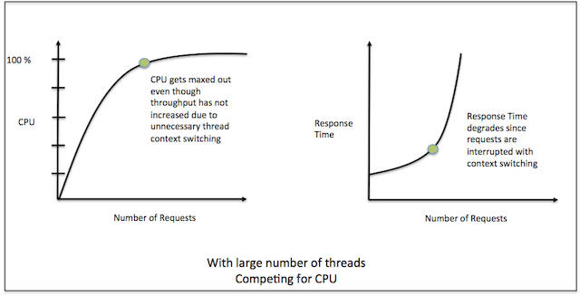
#5 Performance degradation

Slide 48
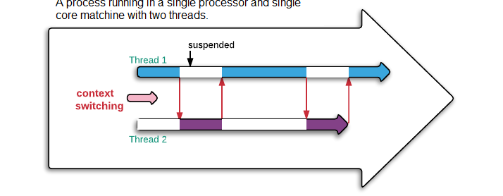
#5 Performance degradation

Slide 49
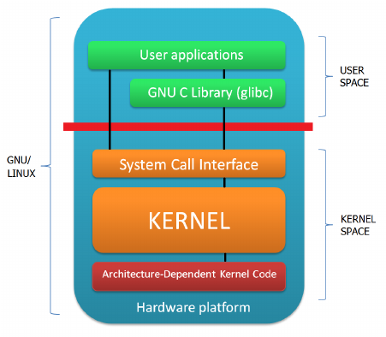
#6 OS limitation

Slide 50

Stop it? Hell no…

Slide 51

#7 Hardware unpredictable optimizations

Slide 52
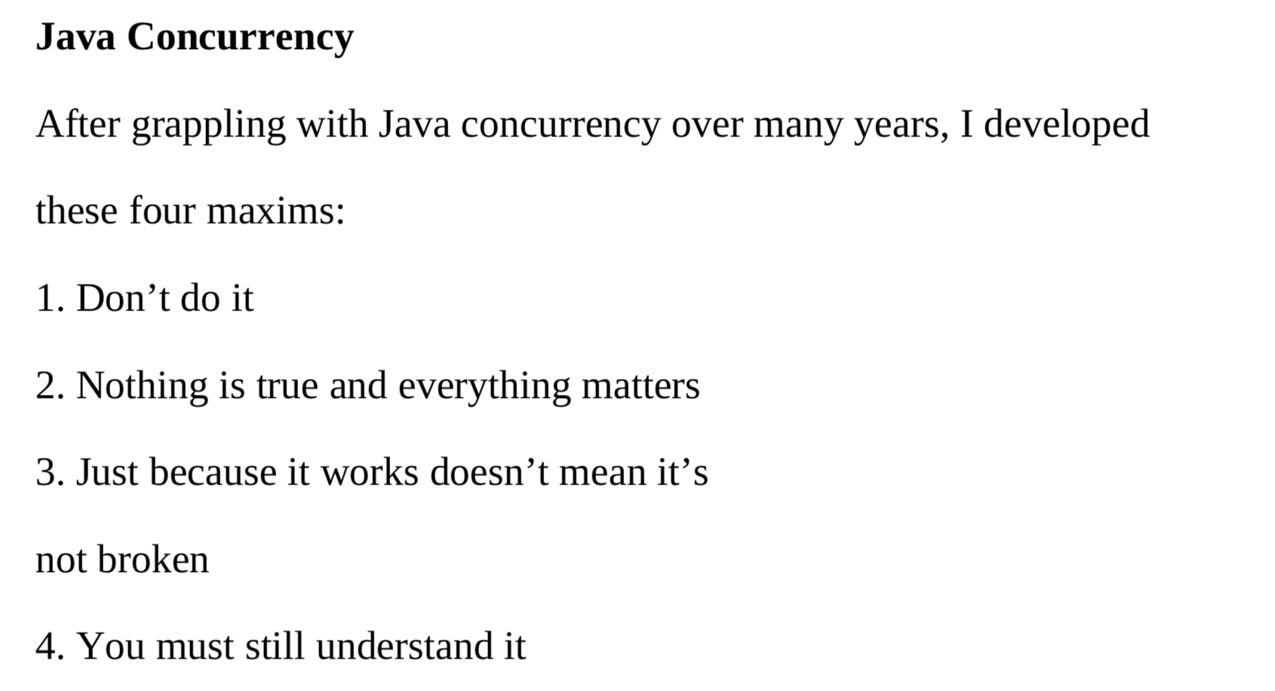
Concurrency in real world
On Java 8 by Bruce Eckel

Slide 53
Conclusion
Concurrency is powerful practice, you can achieve a lot using it
Don’t use concurrency if you can avoid it
Use best practices by experts
Use frameworks with big professional community
Minimize synchronization and data sharing
Perform load and stress testing
Use as much as possible existed solutions
Don’t forget about mad world and wonders

Slide 54
Resources
Java concurrency in practice (Brian Goetz )
On Java 8 (Bruce Eckel)
The Art of Multiprocessor Programming (Maurice Herlihy , Nir Shavit )

Slide 55
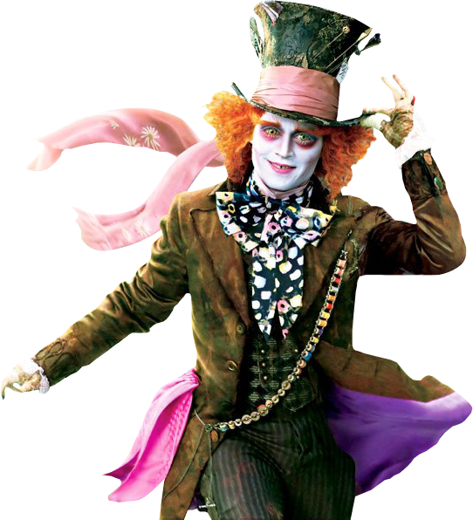
THANK YOU!
artyom-karnov@yandex.ru, Saint-Petersburg, 2019

